Slide 1
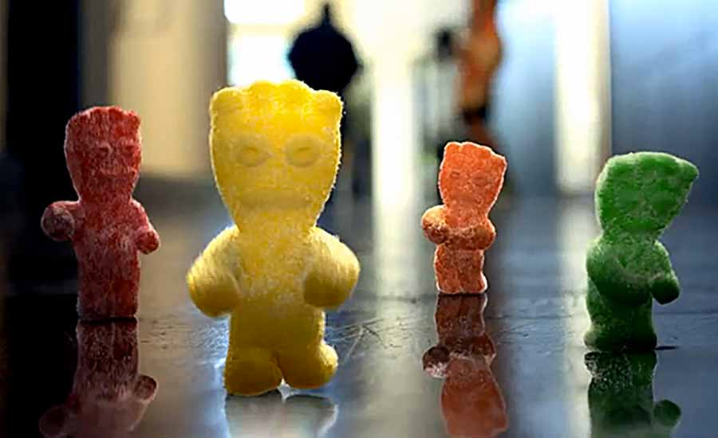
Sweet & Sour Sentiment
On the Street
Ayala, Joseph
Behrman, Andrew
Fox, Mike
Hankinson, Michael

Slide 2
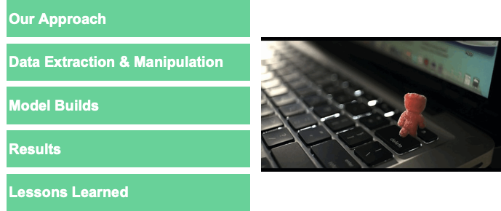
Our Agenda

Slide 3

Executive Summary
Can automated sentiment analysis of quarterly earnings calls provide a glimpse of the short-term price movements to come during trading hours? For our final project, we will analyze the earnings call transcripts (text) of ~100 of the largest companies in the United States, which are listed on a national stock exchange, indicated by their presence in the highly monitored “S&P 500 Index”.
Specifically, we will look to analyze the sentiment within the following categories of the earnings call:
management presentation
Wall Street sell-side analyst questions
corresponding management answers to those questions.

Slide 4

Our Approach
The original idea was to do a tonal analysis to provide sentiment analysis but we became aware that the collection of data for this would be overly burdensome
Another idea was to take a sentiment analysis product and prove its worth
We then realized we could train our own sentiment model!
First step was for resident SME to take 3,000 sentences from earnings calls and rate them from extremely negative to neutral to extremely positive
Next do a K-means and look for possible clusters, information to build from
Then train a model using created sentiment analysis on larger datasets to make next day predictions of the stock market
Test the models
Lastly, perform regression analysis, etc.

Slide 5
Measures of Performance
1 | Earnings Call Transcripts |  | Text data obtained from “Seeking Alpha” earnings call transcript URLs, by ticker Parsed text data into individual sentences, rolling up to certain call sections
2 | Vader Sentiment Score |  | Developed Vader scores for each sentence in a given transcript and incorporated each score into our final data frame
3 | Proprietary Sentiment Score |  | Employed our “domain expertise” to rank sample size of 3,000 sentences from 1 to 5 Fed labels into ML models, which provided output for remaining sentences in DF
4 | Market Capitalization |  | Obtained via “Pandas DataReader” library for date of earnings call
5 | Trading Volume |  | Obtained via “Pandas DataReader” library for all dates during 2019
6 | Stock Closing Price |  | Obtained via “Pandas DataReader” library for all dates during 2019

Slide 6
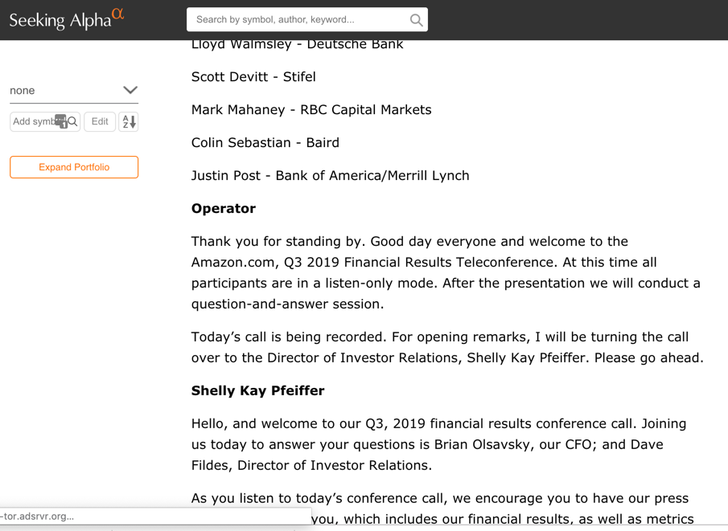
Web Scraping
1.
Visit SeekingAlpha Earnings News for selected ticker
2.
Select most recent Earnings Call found and browse to that page
3.
Scrape the meeting participants and the transcript from the website
Notes:
describes relevant measures of your performance
https://www.google.com/webhp?sourceid=chrome-instant&rlz=1C5CHFA_enUS506US506&ion=1&espv=2&ie=UTF-8#q=measure+of+performance+capsim

Slide 7
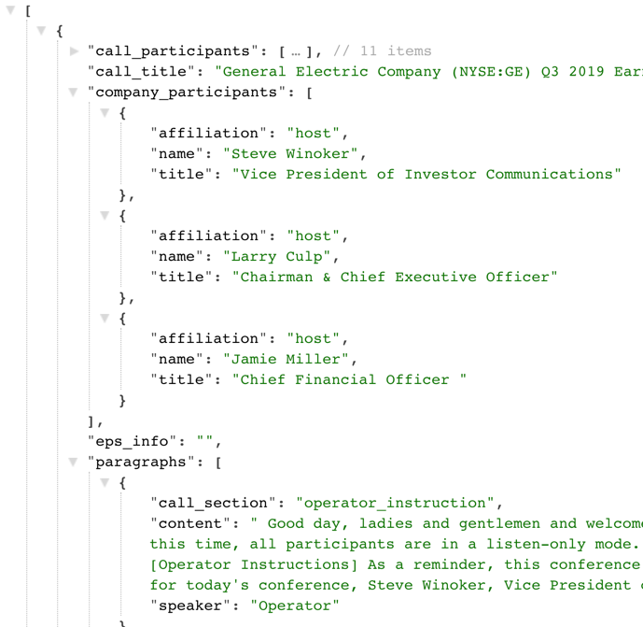


Web Scraping
4.
Visit SeekingAlpha Earnings News for selected ticker
5.
Store json into MongoDb
6.
Parse content from MongoDb into sentences using nltk library and output a csv
Notes:
describes relevant measures of your performance
https://www.google.com/webhp?sourceid=chrome-instant&rlz=1C5CHFA_enUS506US506&ion=1&espv=2&ie=UTF-8#q=measure+of+performance+capsim

Slide 8
Web Scraping Data Summary
Phase 1: Started with 10 Earnings Calls from select S&P 500 members
5160 sentences collected
Random sample of 3000 selected for training/validation
Phase 2: Targeted random 100 members from S&P 500 for stock change predictions
Collected 42,941 sentences tagged with speaker name and call section from 82 companies (18 scrapings failed)
Call section was either ‘Presentation’, ‘Operator Instruction’, ‘Question’, ‘Answer’
Notes:
describes relevant measures of your performance
https://www.google.com/webhp?sourceid=chrome-instant&rlz=1C5CHFA_enUS506US506&ion=1&espv=2&ie=UTF-8#q=measure+of+performance+capsim

Slide 9


Data Manipulation
1.
Merged data frames on “ticker’ and “call date”
2.
Determined “base date” and “market date” to calculate price & volume performance after earnings call
Insert Plots
3.
Developed and studied plots to develop understanding of our data
Notes:
describes relevant measures of your performance
https://www.google.com/webhp?sourceid=chrome-instant&rlz=1C5CHFA_enUS506US506&ion=1&espv=2&ie=UTF-8#q=measure+of+performance+capsim

Slide 10
Model Build
Profit
Stock Price
Market Cap
Return on Equity
Return on Assets

Slide 11
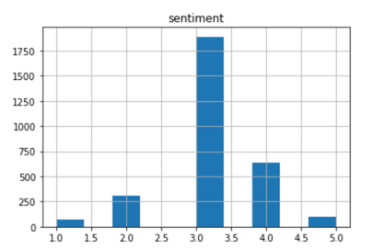
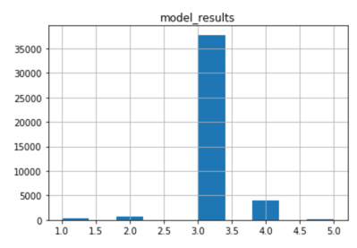
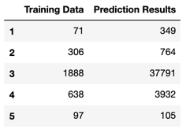
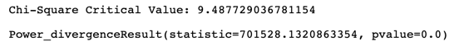
Sentiment Predictor Results
Accuracy: 61.6%
Finding:
Since the chi square value of 701,528 exceeds the critical value of 9.49, we conclude that the results are statistically significant and there is a difference between the data sets. This is not desirable in this case.
Notes:
R3 win
R2 last
R3 when phase out lower end and trad products
round 7 emergency loan

Slide 12
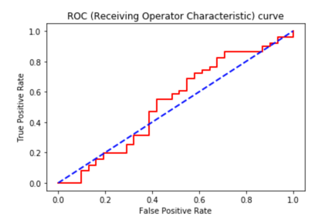
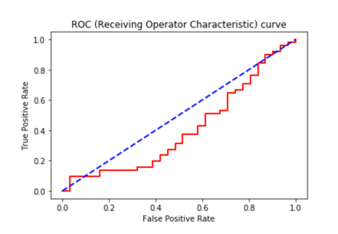
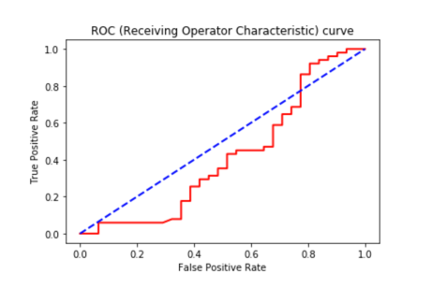
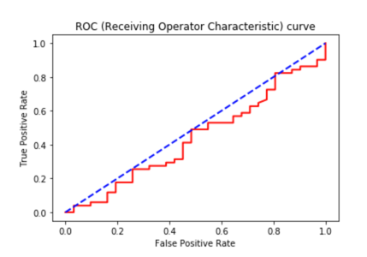
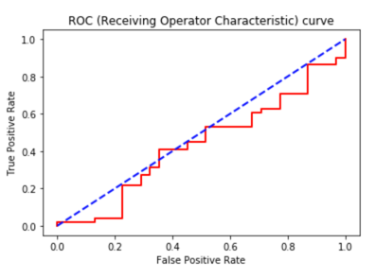
Price Predictor Results: Logistic Regression
All Features
Vader Sentiment
Sweet n Sour Sentiment
Pseudo R^2: 0.002
LLR p-value: 0.861
Pseudo R^2: 0.001
LLR p-value: 0.918
Pseudo R^2: 0.067
LLR p-value: 0.047
K-Means
Market Parameters
Pseudo R^2: 0.020
LLR p-value: 0.081
Pseudo R^2: 0.019
LLR p-value: 0.011
Notes:
R3 win
R2 last
R3 when phase out lower end and trad products
round 7 emergency loan

Slide 13
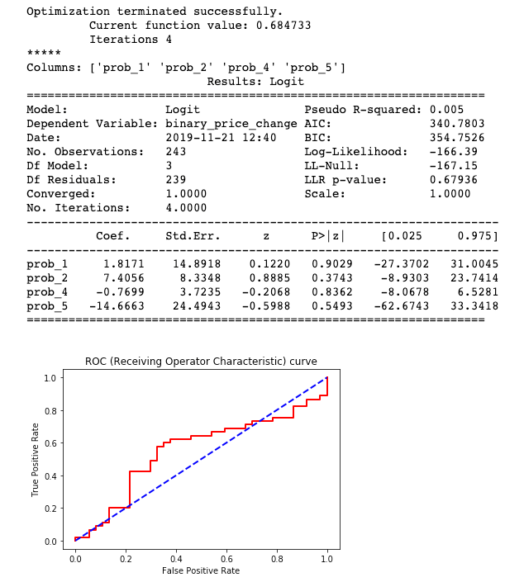
Price Predictor Results: Logistic Regression
Re-ran regression based on 5-category sentiment probability instead of 1-hot sentiment category.
Results improved in regards to model’s ability to predict result, but the correlation statistics are still very weak.
NOTE: If model predicted ”price increase” every time, it would be correct 55% of the time. So model accuracy of 68% is still better than worst case.
Notes:
R3 win
R2 last
R3 when phase out lower end and trad products
round 7 emergency loan

Slide 14
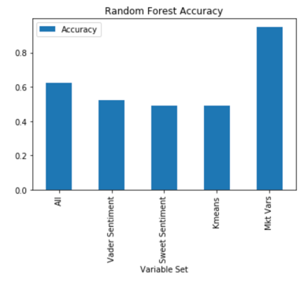
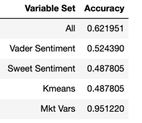
Price Predictor Results: Random Forest Classifier
Re-ran regression based on 5-category sentiment probability instead of 1-hot sentiment category.
Results improved in regards to model’s ability to predict result based on Sweet Sentiment from 49% to 51%. But this is still worse than if the model simply predicted a “price increase” every time which would yield an accuracy of 55%.
Notes:
R3 win
R2 last
R3 when phase out lower end and trad products
round 7 emergency loan

Slide 15
Lessons Learned
Positive
Operating rhythm and division of labor
Creating solutions for certain constraints faced on data acquisition and manipulation
Application of ML content to construct a “proprietary model”
Constructive
Confirmation of robust source datasets
Obtaining both a broad and diverse set of data to analyze
Time consumption of ML model build and configuration
Unsupervised model – limited ability to aggregate and analyze results
Consider further advance topics to improve our model prediction/accuracy

